Slide 1
FUNDAMENTALS -
DOCKER
(Containers)
LECTURE II - III
Jose Luis Gómez Ortega
MDA - MIA
2024
Notes:
<número>

Slide 2


Agenda
1. Containers
2. Docker

Slide 3
Containers
1

Slide 4
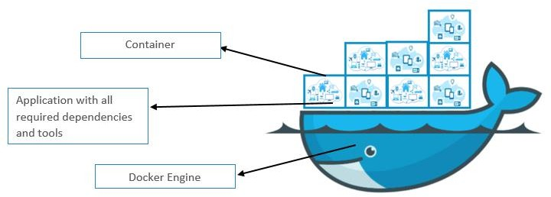
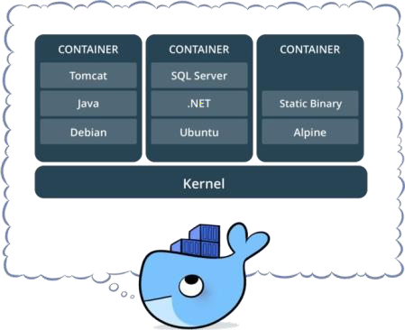
What is a Container?
Standardized packaging for software and dependencies
Lightweight Packaging of everything needed to run one o multiple processes: code, system tools, dependencies, etc.
◉
Insolate apps from each other
◉
Share the same OS Kernel
Works with all major Linux and Windows Server

Slide 5
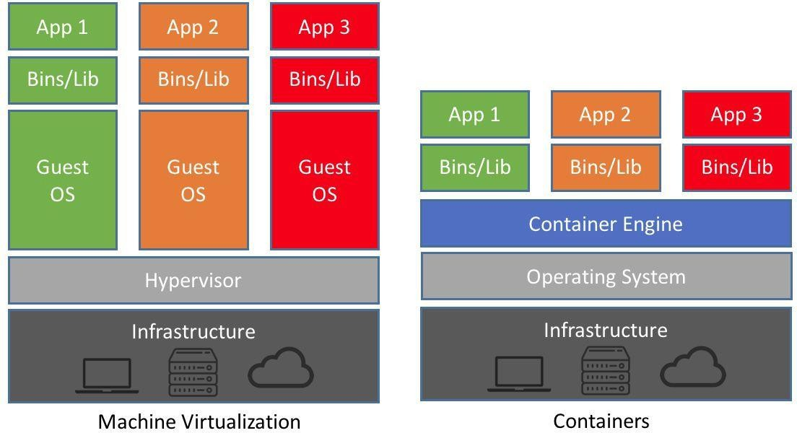
Containers vs. VMs

Slide 6

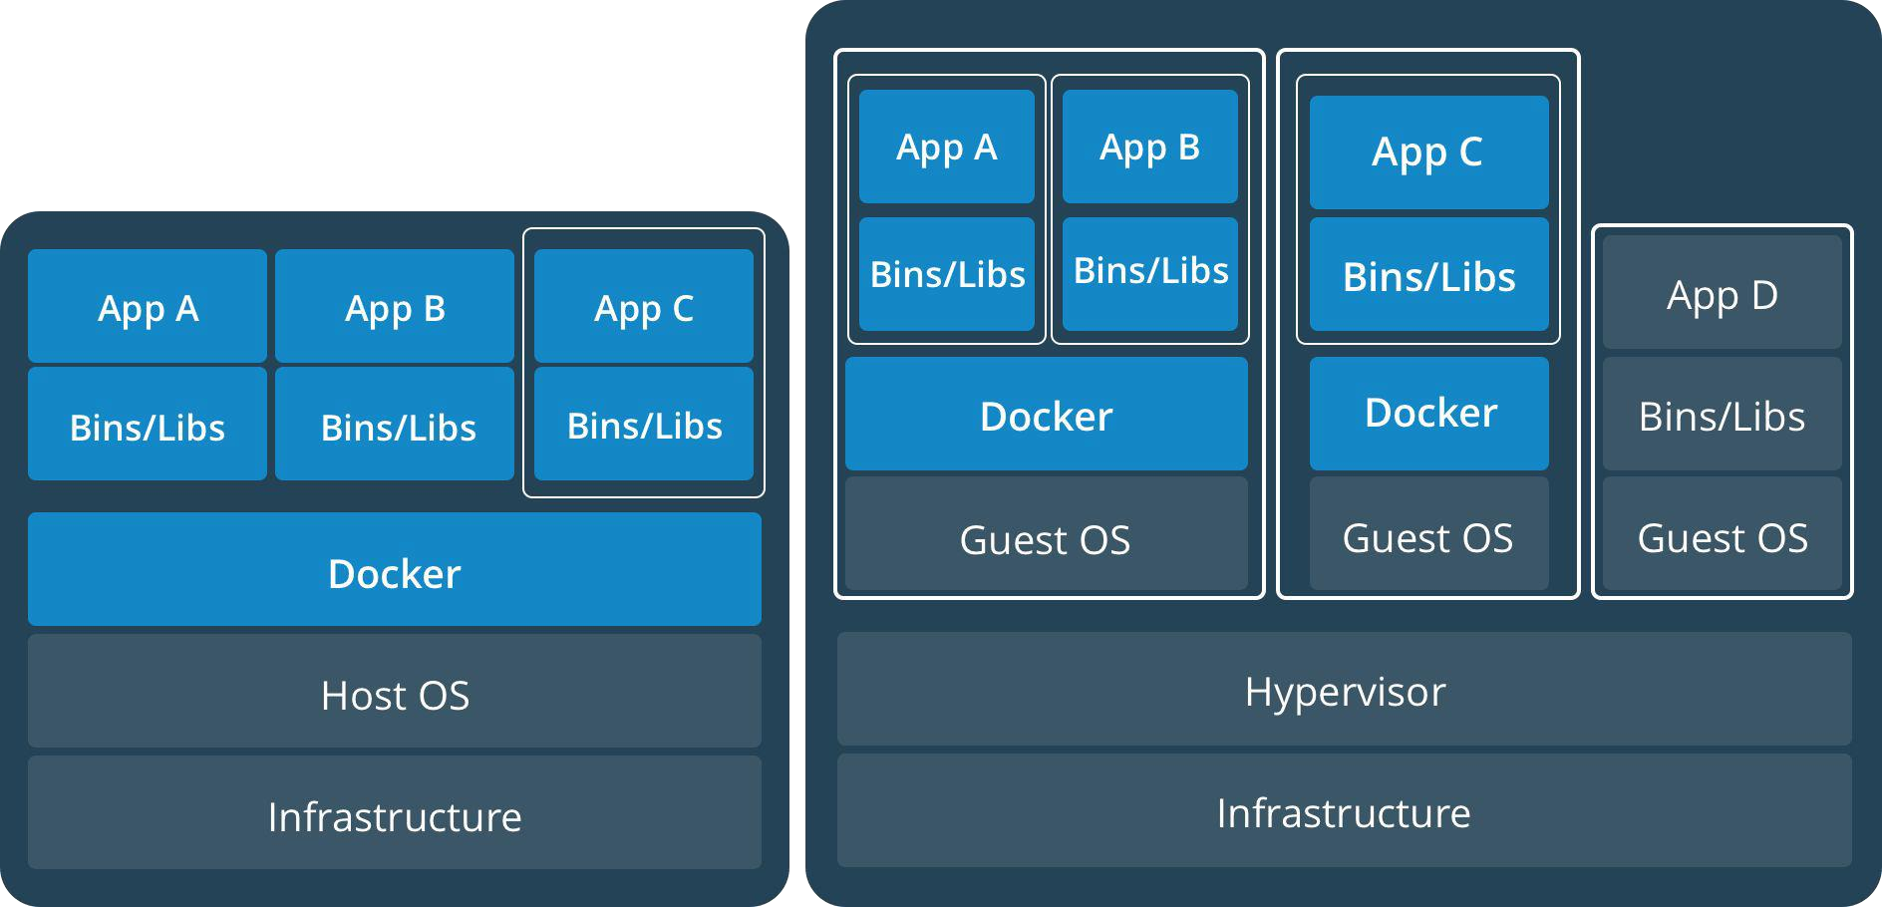
Containers & VMs together

Slide 7





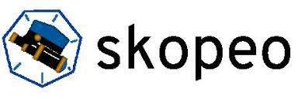
Container Runtimes

Slide 8
Docker
2

Slide 9
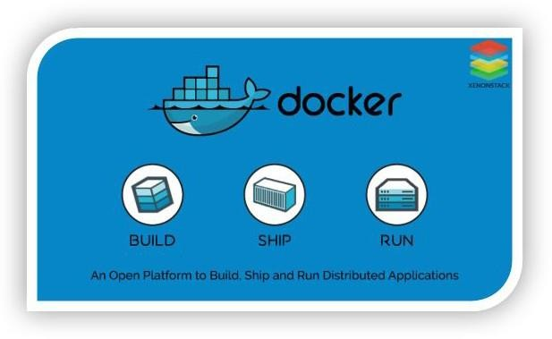
Docker
Docker is an open platform for developing, shipping, and running containerized applications
With Docker, you can manage your infrastructure in the same way you manage your applications
No OS to boot →
Applications online in seconds

Slide 10

Hands-on
Docker in your laptop
Windows Users (Windows 10 Enterprise & pro & home):
https://docs.docker.com/desktop/windows/install/
Mac Users
https://docs.docker.com/desktop/mac/install/
Ubuntu Users
https://docs.docker.com/engine/install/ubuntu/

Slide 11
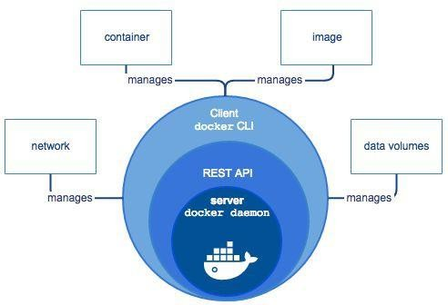
Docker Versions
https://hub.docker.com/
Docker Engine is a client-server application with these major components:
Available for Linux
Docker Daemon (Server) (dockerd)
REST API
Docker Client (Command Line Interface (CLI))
Docker Desktop:
Contains Docker Engine
Available for Windows, Linux and Mac
Focus on Development Environments
Contains additional tools such as docker-compose, GUI, etc.
Offers different subscriptions & prices

Slide 12
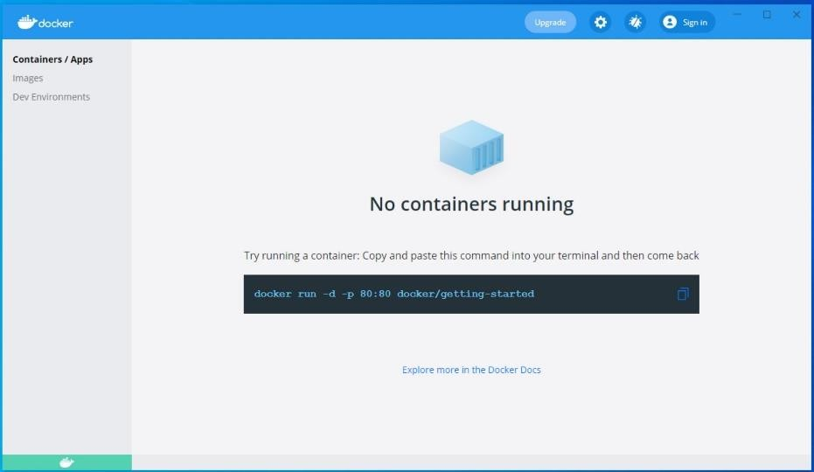
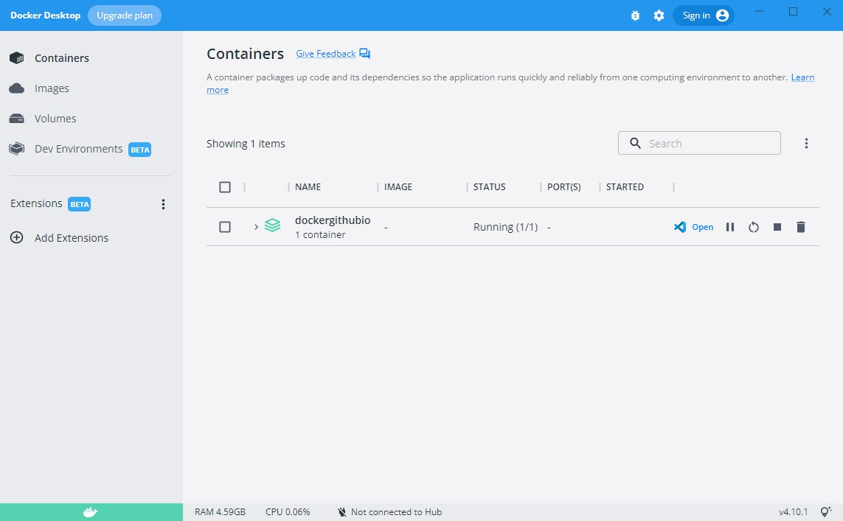
Docker Desktop

Slide 13
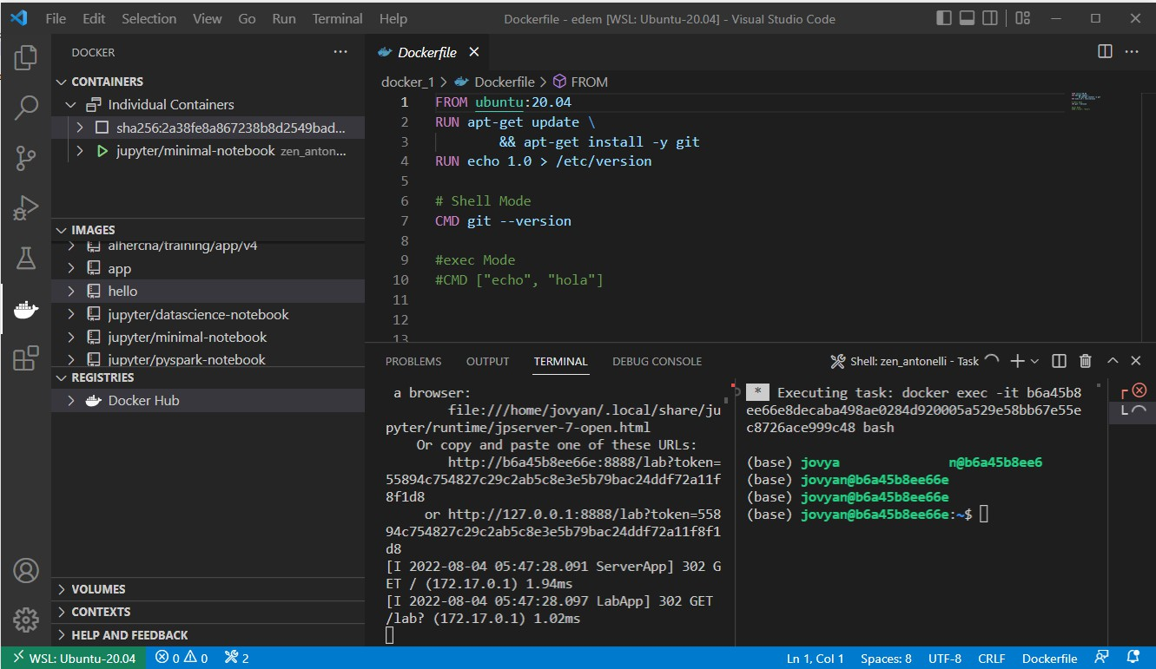
Visual Studio Code

Slide 14

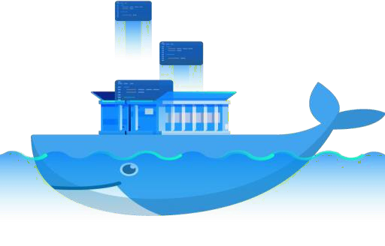
Docker Image
A Docker Image is like an Instalación CD
A read-only template
Recognized by name or Image ID
They are pushed to and can be pulled from Docker Hub

Slide 15
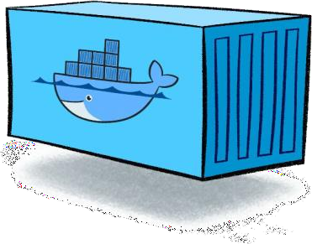
Docker Container
Running instance of a Docker Image
Provides similar isolation to VMs but lighter!
Adds writable layer on top of image layers and works on it
Can talk to other containers like processes in Linux
Provide resources (CPU/RAM) to an image

Slide 16
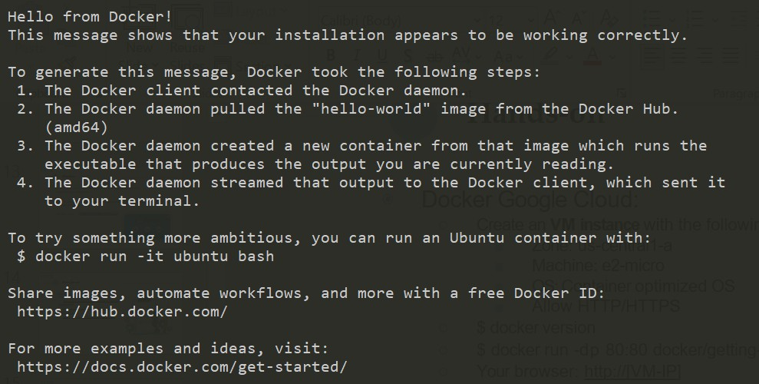
Hands-on
‘‘‘docker run hello-world’’’

Slide 17
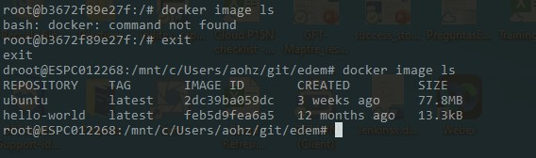
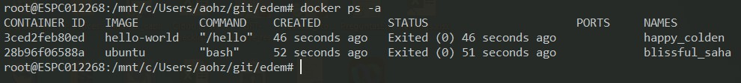
Hands-on – Basic Comands
“docker version”
“docker –help”
“docker image”
“docker image --help”
“docker image ls”
“docker ps”
“docker ps -a”
“docker run <image>”
“docker run –it <image>”

Slide 18
Hands-on
Exercise 1A
Exercise 1B
1. List Docker images
1. List Docker images
2. Create a new <hello-world> container
2. Create a new <Ubuntu> container
3. List Docker images
3. List Docker images
4. List running containers
4. List running containers
5. List all containers
5. List all containers
TIP!
docker run –it <image_id>

Slide 19
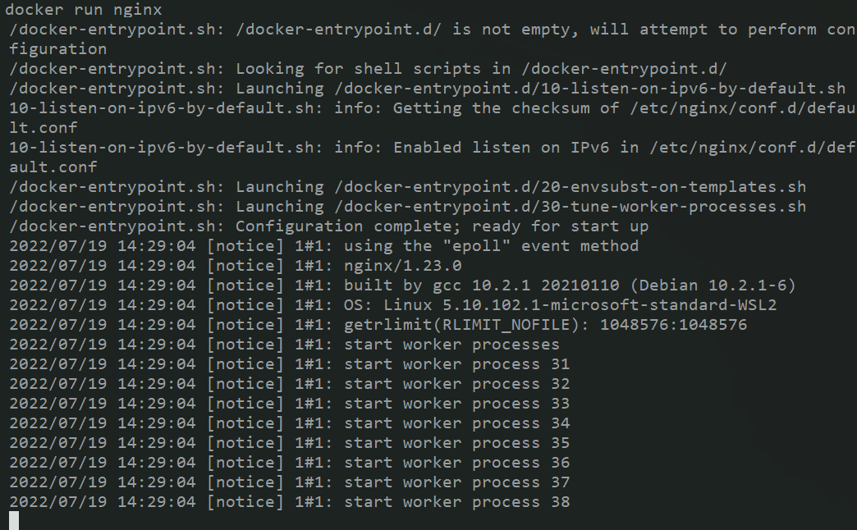
Hands-on – Background Containers
“docker run jupyter/base-notebook”
“docker run -d jupyter/base-notebook”
“docker stop <container_id>”
“docker start <container_id>”
“docker rm <container_id>”
“docker rmi <image_id>”

Slide 20
Hands-on
Exercise 2
Run a jupyter container
How many jupyter images/containers do you have?
Run a new jupyter container
How many jupyter images/containers do you have?
Stop and start them
How many jupyter images/containers do you have?

Slide 21
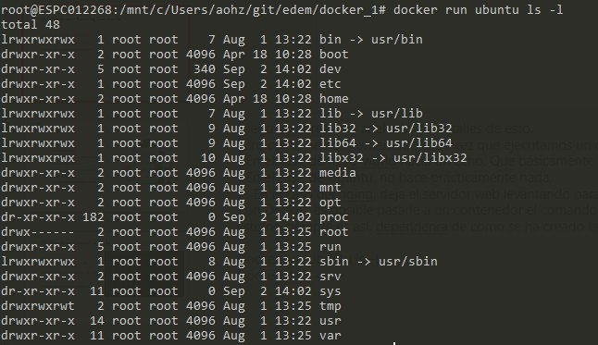
Hands-on – Running Commands in Containers
3 Main ways to interact with a Docker Container:
“docker run ubuntu <command>”
“docker start –i <container>
“docker exec ubuntu <command>”
“docker cp <source> <target>”

Slide 22
Hands-on
Exercise 3a
Exercise 3b
1. List the content of an Ubuntu Container using run
1. Create a Nginx Container
2. Copy a file in the container
2. List the content of a Nginx Container using exec
3. List the content of an Ubuntu Container using start
3. Copy a file in the container
4. List the content of an Ubuntu Container using exec

Slide 23
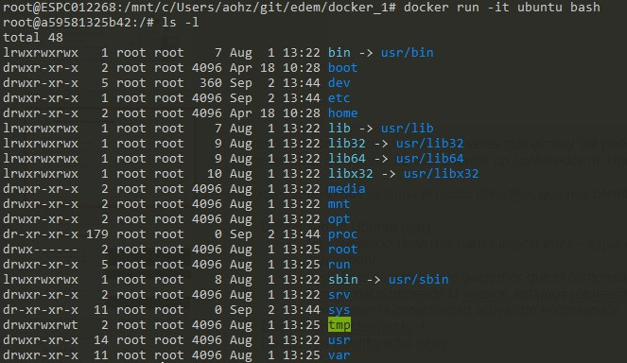
Hands-on – Iteractive Mode
“docker run –it ubuntu”
“docker start –i <container_id>”
“docker exec –it <container_id> bash”

Slide 24
Hands-on
Exercise 4 (Optional)
Get into an Ubuntu Container using run and list its
content
Get into an Ubuntu Container using start and list its content
Get into an Ubuntu Container using exec and list its content

Slide 25
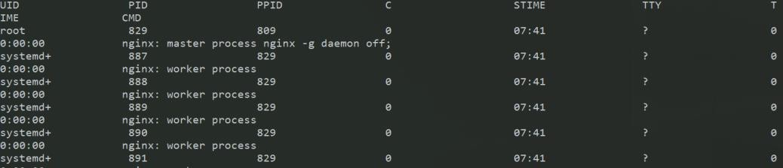
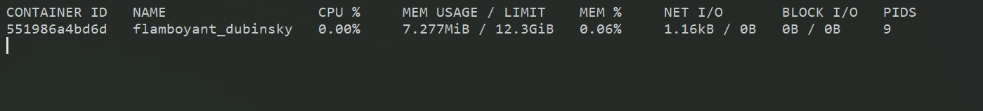
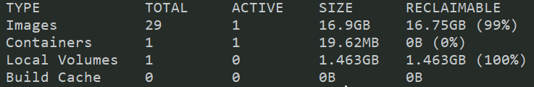
Hands-on – Monitoring
“docker logs <container_id>”
“docker top <container_id>”
“docker stats <container_id>”
“docker inspect <container_id> / <image_id>”
“docker system df”

Slide 26
Hands-on
Exercise 5
Run a jupyter container
Get information about the processes running on it
Get information about memory usage
Open another terminal:
Enter the container and run “apt-get update”
Any changes?

Slide 27
Hands-on - review
Exercise 6
Run a Fedora Docker container
run wget Google.com
Is wget installed?
Install wget
Stop and start the container: is wget installed?
Install wget
Create a new container from the same image: is wget
Installed?
TIP!
To install wget:
yum upgrade
yum install wget
27

Slide 28
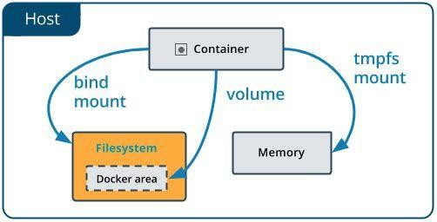
Docker Volumes and Bind Mounts
What happens to the data if a container crash o removed?
Data could be lost!!!
Docker has two options for containers to store files in the host
machine:
Volumes (Anonymus and Nammed)
Bind mounts
Volumes and Bind Mounts have the following features:
They allow to persist the information when the container is destroyed
They allow to share information with the host machine
They allow to share information with other docker containers

Slide 29
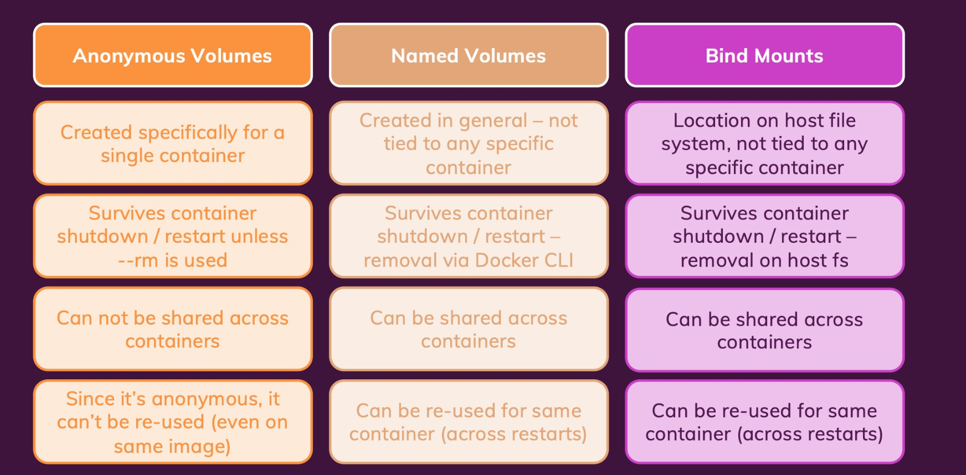
Docker Volume and Bind Mounts

Slide 30
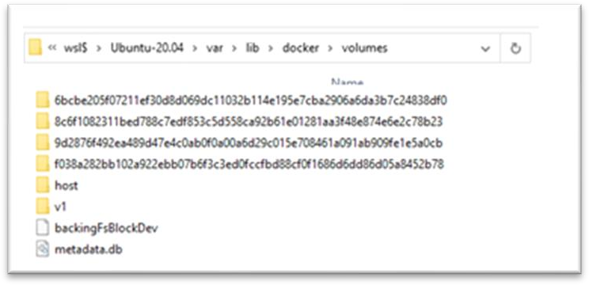
Hands-on – Volumen & Bind Mounts
Basic Volume Commands
docker volume create myvol
docker volume ls
docker volume inspect myvol
Docker volume prune
Attaching Volumes to a container
Named Volume: docker run -v <volume_name>:/<container_path> <image_id>
Anonymous Volume: docker run -v :/<container_path> <image_id>
Attaching Bind Mounts to a container
docker run –v /<host_path>:<container_path> <image_id>

Slide 31
Hands-on
Exercise 7a
Exercise 7b
1. Create an Ubuntu container with a volume
mounted (ubuntu1)
1. Do the same thing with Bind mounts
2. Verify that no volumes are created
Verify that the volumen has been created
Create another Ubuntu container with the same volume mounted (ubuntu2)
Create a file inside the mounted folder using ubuntu1
Verify it exists on Ubuntu2

Slide 32
Hands-on
Exercise 8
Create a docker container:
use <httpd> docker Image
Expose the port 80 (-p 80:80)
Mount docker path “/usr/local/apache2/htdocs/ “ to the host file system
Create a index.html file inside the mounted folder
Type in your Browser localhost:80

Slide 33
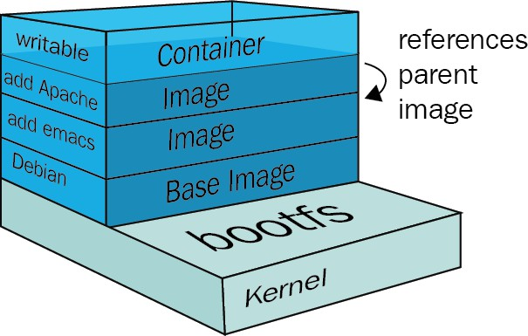
Docker Image Layers
Docker images are made up of several read-only layers
Assemble the last layer, the container
(read/write)
Assemble the N layers of the image (read)
Assemble the root systems (read)
Assemble the Boot System (read)

Slide 34
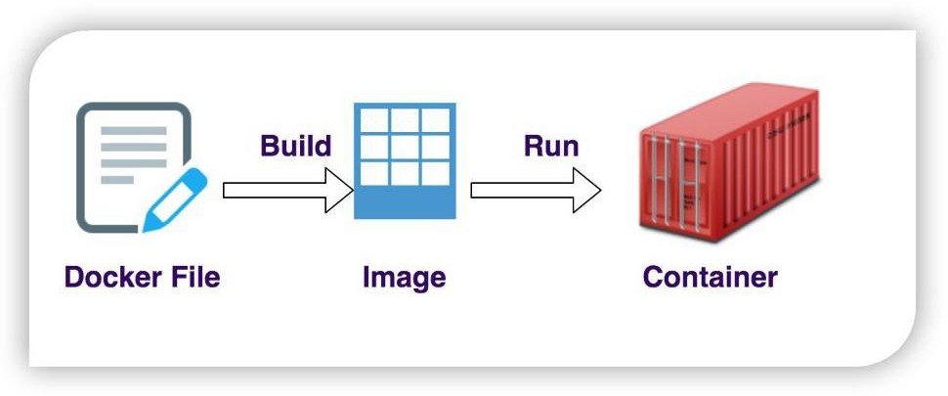
Docker File

Slide 35
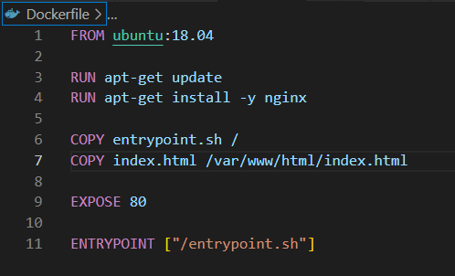
Docker File
A DockerFile is a text document that contains all the commands a user could call on the command line to assemble an image
You can consider DockerFile as blueprint of Docker Image
DockerFile as a sequential set of instruction for Docker Engine
Order of sequence is important!!
Each instruction creates a layer
A stack of such sequenced layers managed by a filesystem becomes a docker image
Layers can be cached and reused by Docker
“docker build .”: Command for building the docker image
“docker run <image>”: Command for creating the docker container from the docker image

Slide 36
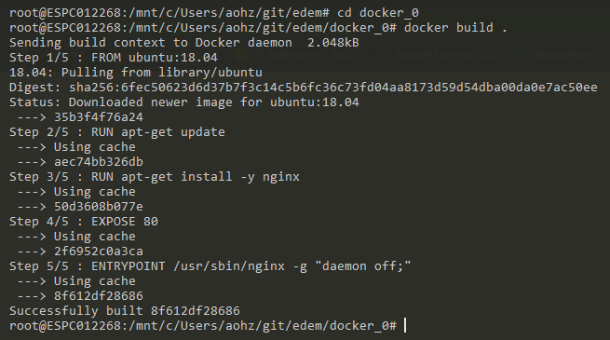
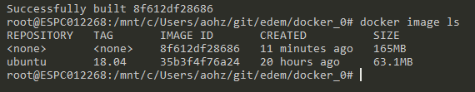
Hands-on – Build Image
“docker build .”
“docker build –t <tag_name> .”
tag_name: {repository}/{image_name}:{version}
“docker run <image>”

Slide 37
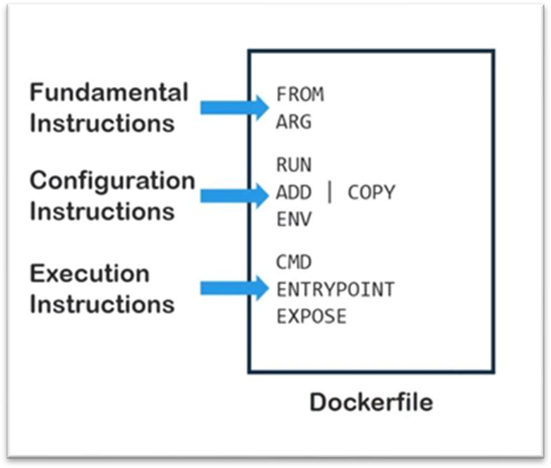
Docker File Structure
It’s a file with no extension called “Dockerfile”
The instructions can be generally divided into three categories :
Fundamental
They are executed when the image is build
Configuration
They are executed when the container is run
Execution:
Both CMD and ENTRYPOINT instructions define what command gets executed when running a container

Slide 38
Hands-on
Exercise 9
Create a new DockerFile to install git on Ubuntu 20.04
Build the docker image
List the docker images
Check the git version installed
TIP!
To install git:
apt-get update
apt-get install -y git
38

Slide 39
CMD and ENTRYPOINT
Both CMD and ENTRYPOINT instructions define what command gets executed when running a container
Dockerfileshould specify at least one of CMD or ENTRYPOINT commands
The ENTRYPOINT specifies a command that will always be executed when the container starts.
The CMD specifies commands/arguments that will be fed to the ENTRYPOINT
If the ENTRYPOINT is not defined, CMD is executed

Slide 40
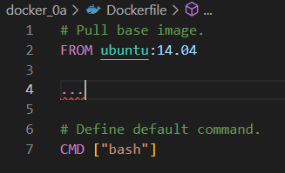
CMD
The CMD specifies commands/arguments that will be fed to the ENTRYPOINT
A Dockerfilemay contains multiple CMD instructions but only the last one is run
CMD can be overridden via command line
Use Cases:
General Purpose Image where the command can be customized when docker run is invoked
$ docker run ubuntu -> run “bash” as it is set in the dockerfile
$ docker run ubuntu ls -l -> run “ls –l ” because it overrides bash command
$ docker run ubuntu cat /etc/hostname -> run “cat /etc/hotmane”

Slide 41
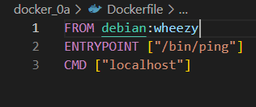
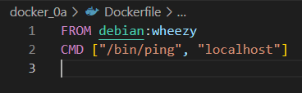
ENTRYPOINT
The ENTRYPOINT specifies a command that will always be executed when the container starts.
The CMD specifies commands/arguments that will be fed to the ENTRYPOINT
Use Cases:
Single Purpose Image where the command can’t be overriden
$ docker run myping -> run “/bin/ping localhost”
$ docker run mypingls -l -> run ““/bin/ping ls –l ”
$ docker run mypinggoogle.com -> run “/bin/ping google.com”
$docker build –t myping .
$ docker run myping2 -> run “/bin/ping localhost”
$ docker run myping2 ls -l -> run ““ls –l ”
$ docker run myping2 google.com -> try to run “google.com”
$docker build –t myping2 .
41

Slide 42
Hands-on
Exercise 10a
Exercise 10b
1. Create a new DockerFile to install git on
Ubuntu 20.04
1. Create a new DockerFile to install git on
Ubuntu 20.04
2. Use <CMD> to print the git version when the container runs
2. Use <ENTRYPOINT> to print the git version when the container runs
3. Build the image
3. Build the image
4. Try to get into the container
4. Try to get into the container

Slide 43
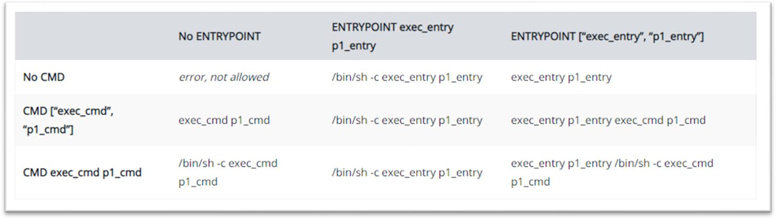
Exec and Shell Forms
Two ways to define the ENTRYPOINT of CMD:
Exec Form: ["/bin/ping", "localhost"] -> Json Array
Shell Form: /bin/ping localhost
Exec form is the preferred way
Exec form don’t expand variables
Multiple combinations of CMD, ENTRYPOINT with Shell or Exec Form may appear in the sameDockerfile

Slide 44
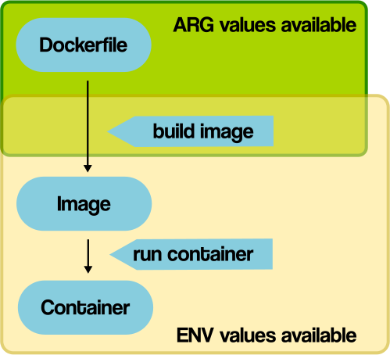
Arguments vs Env. Variables
Both are Dockerfile instructions
Arguments (ARG)
Args are visible when the image is built
Args are not visible inside the container (unless we assign its value to an environment variable (ENV env_1=$arg_1)
Args can be overridden during build time using --build-arg VAR_NAME=6
Environment Variables (ENV)
Env are visible during the image build and inside Docker containers
Envs can’t be overridden during build time

Slide 45
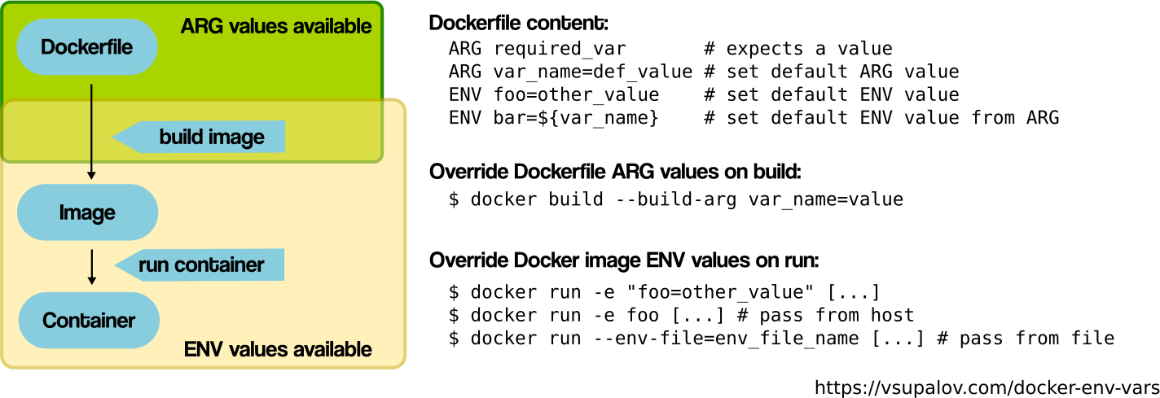
Arguments vs Env. Variables

Slide 46
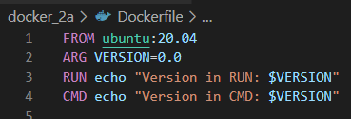
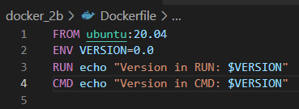
Arguments vs Env. Variables
What is printed …?
In line 3, running docker build . ?
In line 3, running
In line 4, running
In line 4, running
What is printed …?
In line 3, running docker build . ?
In line 3, running docker build -e VERSION=1.0 ?
In line 4, running docker run <container> ?
In line 4, running docker run <container> -e VERSION=1.0 ?
docker build –build-arg VERSION=1.0
?
docker run <container>
?
docker run <container> –build-arg
VERSION=1.0?

Slide 47
Hands-on
<html>
<head>
<title> Ubuntu rocks!
</title>
</head>
<body> <p> This is my website!
</p> </body>
</html>
Exercise 11
Create an image from Ubuntu:18.04
Install nginx
Create a index.html file with the following content
Copy the index.html file to /var/www/html/index.html
Create and use entrypoint.sh script
Use entrypoint.sh script as ENTRYPOINT to start nginx
Index.html
#!/bin/bash
/usr/sbin/nginx -g "daemon off;"
Bonus!
Change the Docker image to allow us to modify the webpage body on runtime
entrypoint.sh

Slide 48
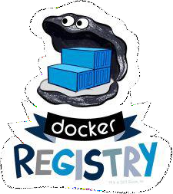
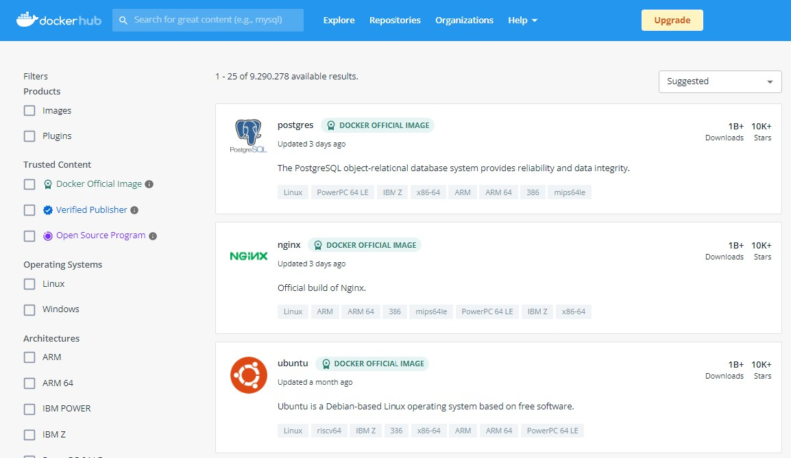
Docker Registry
The Registry is a stateless, highly scalable server side application that stores and lets you distribute Docker images
Fully own your images distribution pipeline
Locally or using Docker Hub
Docker login <Registry>
Docker tag SRC_IMAGE[:TAG] TARGET_IMAGE[:TAG]
Docker push<IMAGE>

Slide 49
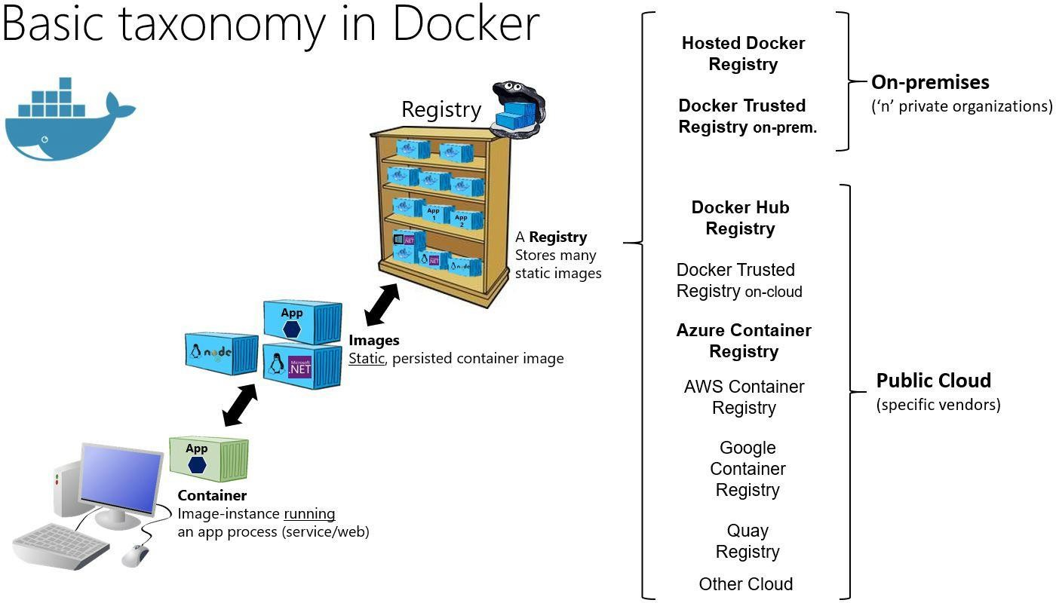

49

Slide 50
Docker Resource Consumption
By default, a container has no resource constraints
Docker provides ways to control how much memory, or CPU a container can use, setting runtime
configuration flags of the docker run command
If the kernel detects that there is not enough memory, it throws an Out Of Memory Exception and
any process is subject to killing, including Docker and other important applications
Main Configuration Flags:
--memory: The maximum amount of memory the container can use
--memory-reservation: The maximum amount of memory the container can use when low
memory is available on the host machine
--cpus: Specify how much of the available CPU resources a container can use
It is possible allow a container to access GPU resources installing the right drives
$docker run -it --cpus=".5" --memory-reservation=‘100m’ –memory=‘1g’ ubuntu /bin/bash

Slide 51

Hands-on – House Keeping
“docker system df”
“docker system prune”
“docker container rm <container / containers>“
“docker image rmi <image / images >“
“docker volume rm <volume / volumes>”
“docker volume prune <volume>”

Slide 52
Hands-on
Exercise 11
1. | Stop all containers
2. | Get information regarding the amount of disk space used by docker
3. | Remove all unused resources
4. | Remove last image, any Issue?
1. | Remove last container and try again
5. | Remove all containers
6. | Remove all images
7. | Remove all unused volumes | ○
 |  | ○
TIP!
Docker commands can be concatenated with other commands
Eg -> docker stop $(docker ps -q)

Slide 53


Thanks!

